Slide 1
Oman Academic Accreditation Authority (OAAA) Oman Qualifications Framework: Project Proposal OQF Oversight Committee 24 June 2014
Notes:
1

Slide 2
Outline
Background
Suggested desired features
Project aim
Project scope
A Consultative approach
Action plan
Committee feedback

Slide 3
Background
Project proposal based on proposal submitted to HE Minister of Higher Education in 2012
The need to develop a comprehensive NQF identified in the development of Oman’s Education Strategy 2040
The need for a comprehensive NQF identified in MoE/World Bank report on quality in education
The current OQF is limited and needs to be aligned with other areas of educational provision (such as school, vocational, technical and professional education)

Slide 4
Suggested desired features
Demonstrates
consistency
Provides pathways
Supports comparability
Supports portability
Supports credibility
Supports international recognition
Allows transparency
Supports recognition of prior learning
Recognises range of learning
Provides a focus on learning outcomes
Provides external reference point
Supports a national understanding of education provision

Slide 5
Project Aim
The aim of this project is to revise and further develop the current OQF into a comprehensive qualifications framework for Oman which, when implemented, will address identified needs across all education sectors in Oman and assist Oman in achieving national goals.

Slide 6
Project Scope
Two main aspects:
Design and creation of a comprehensive OQF
Planning for the effective implementation and maintenance of the framework
Three stages of the project:
STAGE A: Development of a conceptual design and supporting rationale and draft policies
STAGE B: Creation and communication of the OQF
STAGE C: Development of a comprehensive plan for the implementation and maintenance of the OQF

Slide 7
A Consultative Approach
A consultative approach is facilitated through:
The formation of an Oversight Committee which represents a wide range of stakeholders
Oversight Committee members supporting consultation within their organisations/peers
The publication of documentation on the OAAA website
The involvement of external experts who will comment on draft versions of documentation
The organisation of a National Symposium to maximise outreach and opportunities to provide feedback
An ongoing media campaign

Slide 8
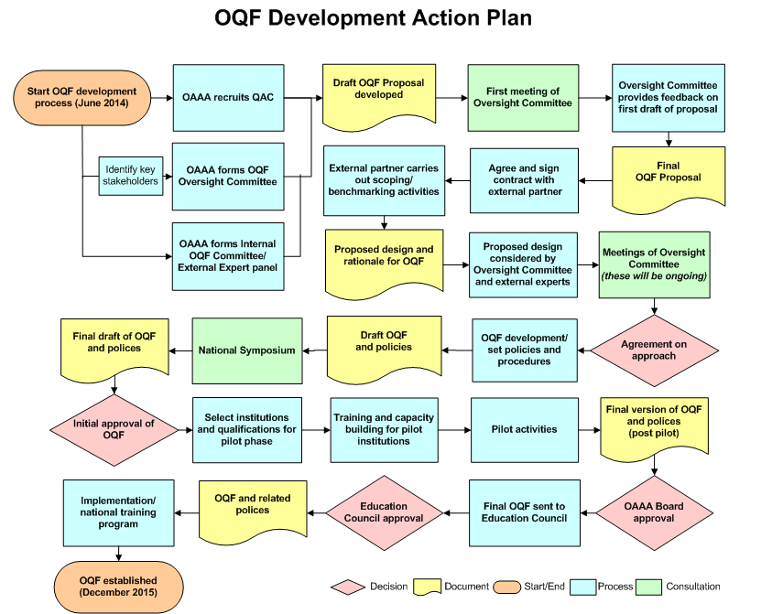
Action Plan

Slide 9
Committee Feedback
OQF Oversight Committee feedback on the draft proposal is important; this proposal will form the basis of the agreed project outcomes and deliverables with the external partner
Feedback to be submitted to Fakhriya Al Habsi by 15 July 2014

Slide 10
www.oaaa.gov.om

